Slide 1

DEMO BACKSTAGE
Kieu Nguyen

Slide 2


Agenda
Introduce
Backstage Architecture
Demo backstage template

Slide 3
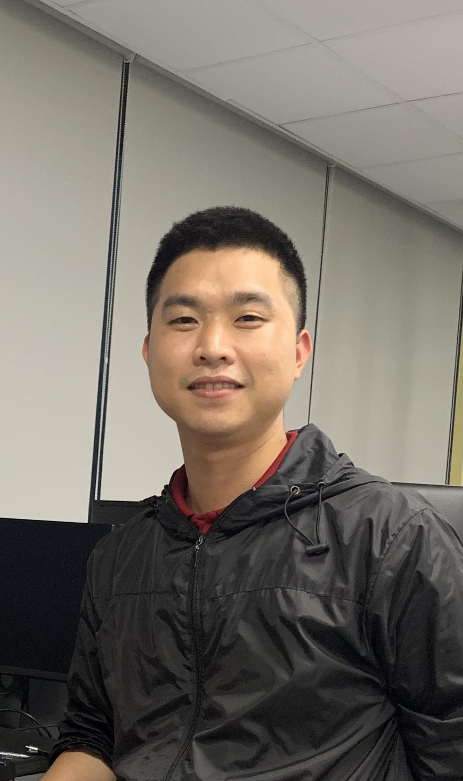
Introduction

Slide 4



Backstage Architecture

Slide 5
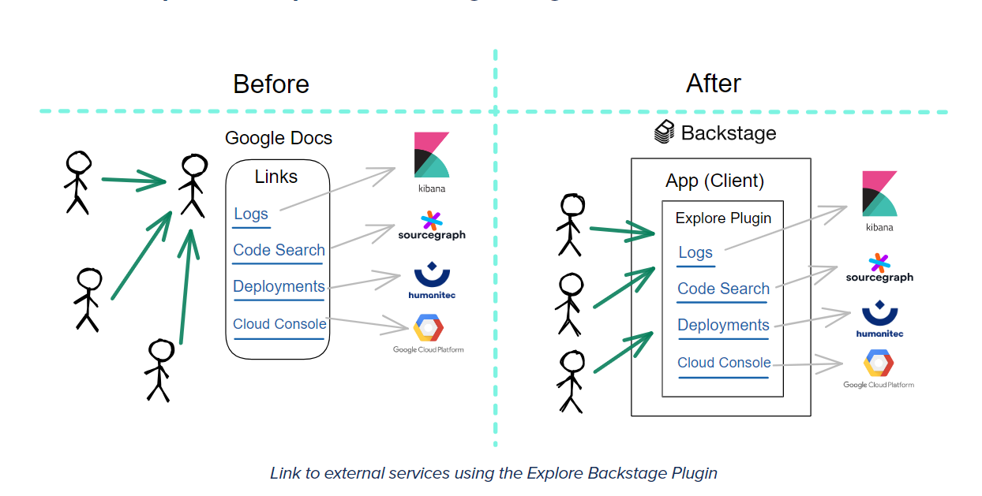
Why BACKSTAGE

Slide 6
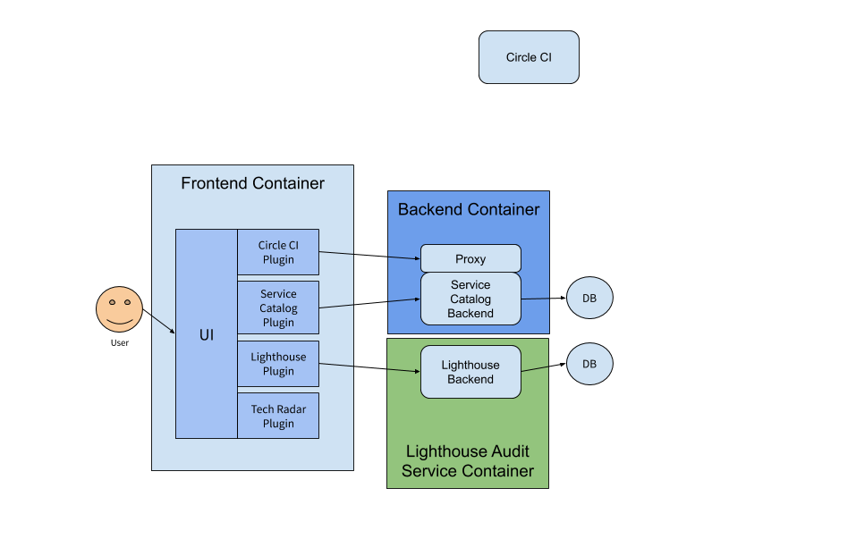
BACKSTAGE ARCHITETURE

Slide 7
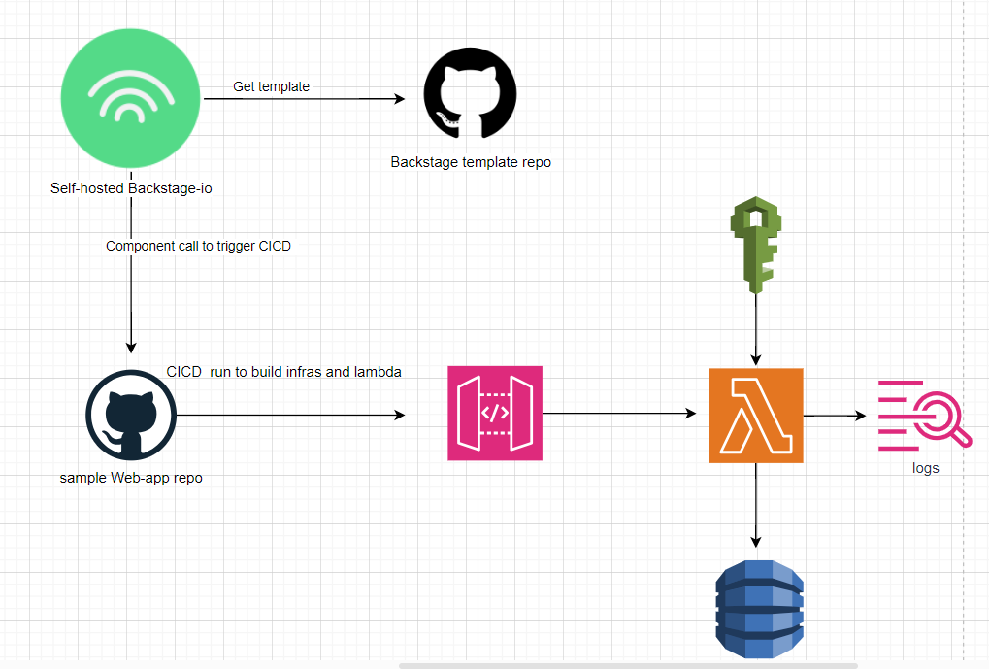
DEMO

Slide 8

Thank you
Presenter Name: Kieu Nguyen
Email Address: kieunguyen.ql@gmail.com

